Slide 1


The Application of AI in Enterprise for Improved Performance, Innovation & Customer Experience
February 2018

Slide 2

2
Company overview.

Slide 3

is living the
Megatrends
right here in Africa.

Slide 4
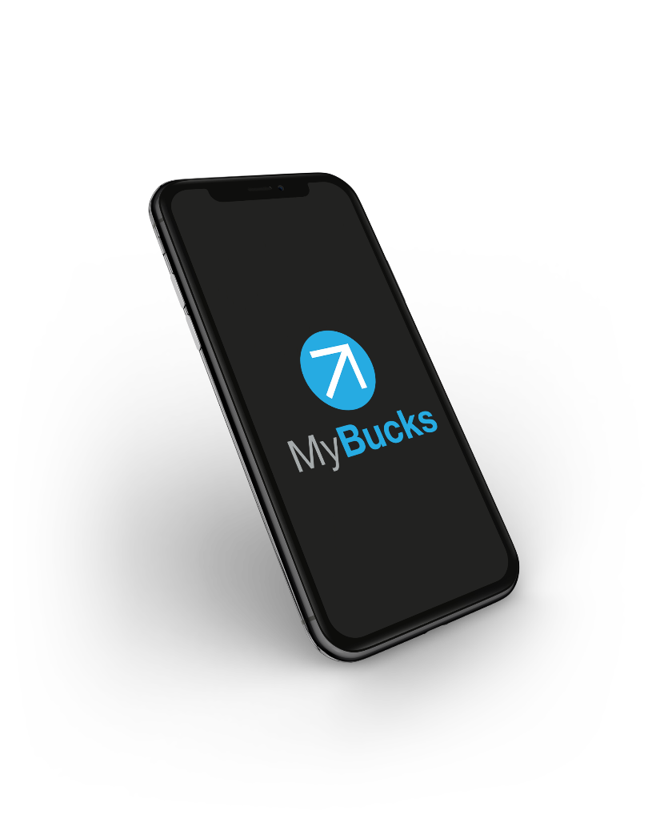
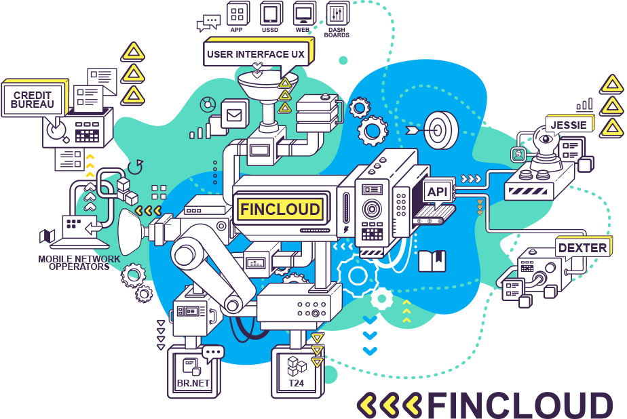

MyBucks Technology.
Artificial intelligence
Best EU Financial Inclusion Company
2017
Big data
Chatbots
Cloud
Open API’s

Slide 5
5
Artificial intelligence.

Slide 6
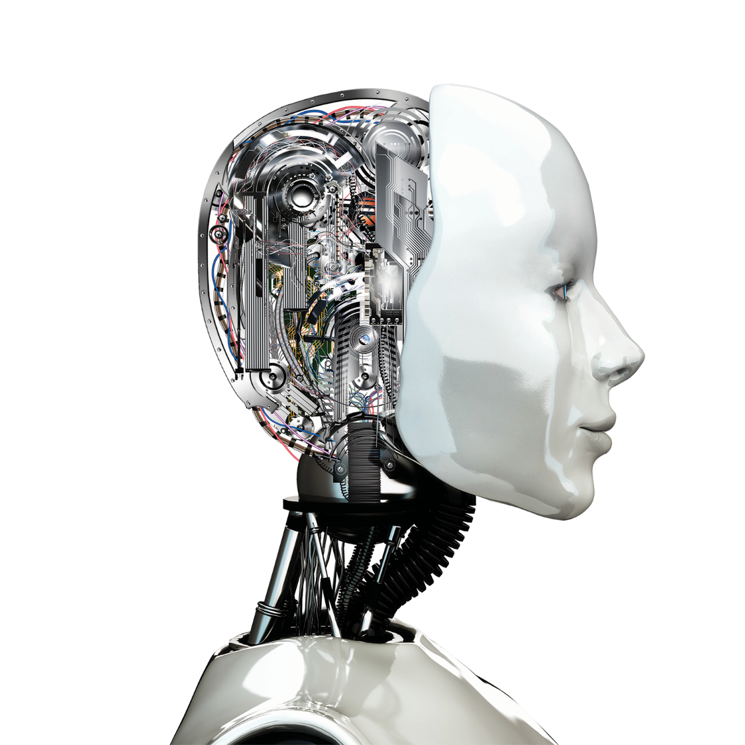

A.I.?
Point of singularity.
According to this hypothesis, an upgradable intelligent agent (such as a computer running software-based artificial general intelligence) would enter a 'runaway reaction' of self-improvement cycles, with each new and more intelligent generation appearing more and more rapidly, causing an intelligence explosion and resulting in a powerful superintelligence that would, qualitatively, far surpass all human intelligence.

Slide 7

What is A.I.?
Age prediction example https://how-old.net/
Segmentation algorithms
Required skill set
Actuarial
Targeted marketing
Retention and win-back
Understanding customer behaviour
Statistics
Maths
Computer
Science
Unstructured data,
Scraping, Natural language,
Social data mining,
Processing
Survival analysis
Time series analysis
Advanced sampling
Machine learning
Classification algorithms
Regression
BENEFITS
FOLKS
GRIT
FOLKS
CHARTER
FUTURE
WORKING-CONDITION
FOCUS
Amount of cars
EXTREME HOURS
LOCATION
WORK
EXCEPTIONAL
Commute distance
Marital status
SCHEDULE
SALARY
ADVANCEMENT
RELATIONSHIPS
Occupation
Region
Children
PEOPLE
Gender
Provisioning
Campaign design & evaluations
Forecasting
IDEAS
HOURS
LUNCH
Home owner
Age
Segment analysis
Market modeling
Behavioural modelling
Predict default
Fraud detection
Risk management
Credit scoring

Slide 8

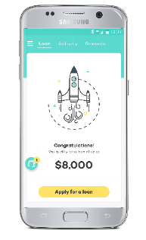
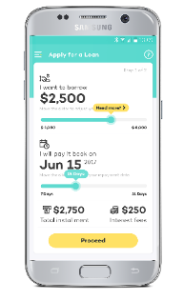




A.I. @ MyBucks.
AI for Innovation
AI for improved customer experience
Tess
A.I.
AI for improved operations
Dexter
Jessie

Slide 9
9
AI for improved operations.

Slide 10
Optimising operations using AI: two big use cases at MyBucks.
DEXTER
Jessie
AI based fraud
detection and prevention
AI based credit
risk model

Slide 11

How?
Start with Data.

Slide 12




How?
A model is “trained” and “evaluated” on existing data.
Train.
Test.
Closed loans (known outcome) together with all the relevant attributes that we will use to make the prediction are used
for training.
We don’t use all the data for training: we keep out a random selection of loans and use it to evaluate the model. Now we can adjust the algorithm parameters, and try different attributes to achieve a better model.
Approve
Decline

Slide 13

The decision boundary.
A machine learning model returns a PROBABILITY of default.
We have to decide on a threshold value, above which the loan will be declined.
Threshold: 50%
2%
40%
80%
Clients with a probability of default higher than the threshold are denied credit.

Slide 14
Using A.I.
‘Unlimited’ number of factors can be considered simultaneously.
Country A
Country B
Classifier ability to distinguish good loan from bad loan
High threshold
 |  | Truth
 |  | Good loan | Bad loan
Classifier prediction | Good loan | 450 | 100
 | Bad loan | 50 | 400
Number
Truth: Good loan
Truth: Bad loan
Low false alarm rate
High miss rate
Good loan
Bad loan
0
Classifier prediction
Low threshold
 |  | Truth
 |  | Good loan | Bad loan
Classifier prediction | Good loan | 400 | 75
 | Bad loan | 100 | 425
Number
Truth: Good loan
Truth: Bad loan
High false alarm rate
Low miss rate
Good loan
Bad loan
0
Classifier prediction
1

Slide 15
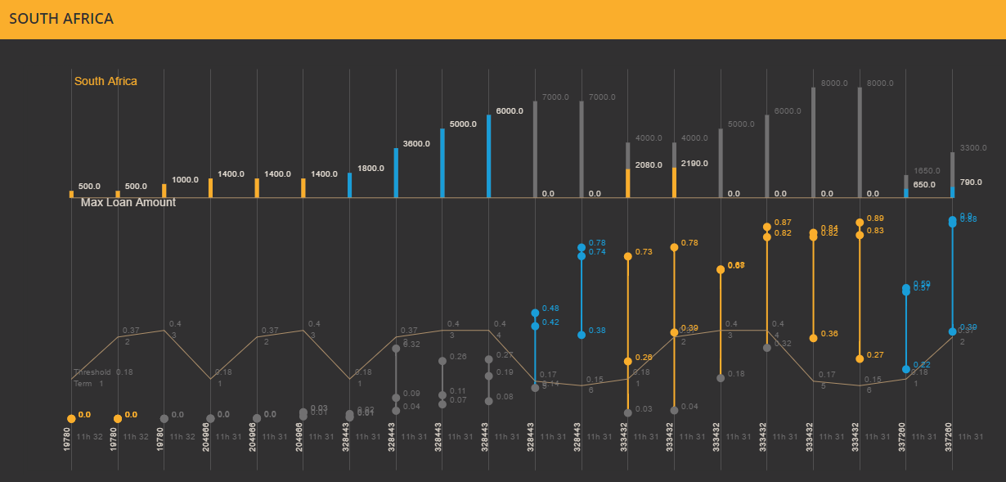
Visualising AI.

Slide 16
Model improvement over time.
Jessie
Control Group

Slide 17

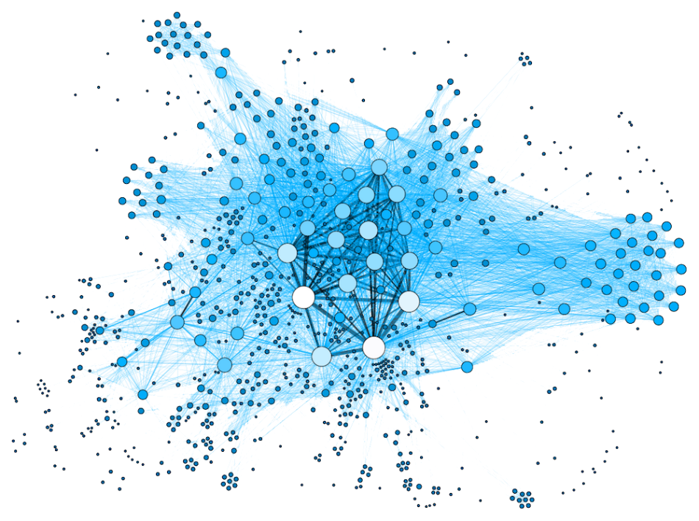
Dexter – AI based fraud detection.
Notes:
And some very interesting software applications…

Slide 18
18
AI for Innovation.

Slide 19

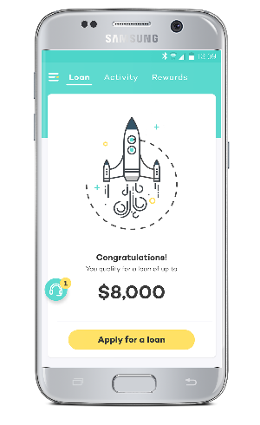
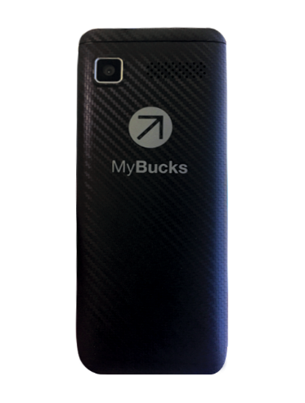
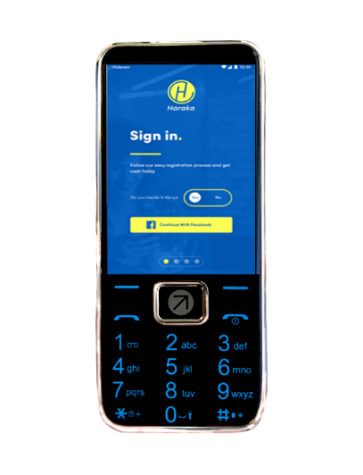
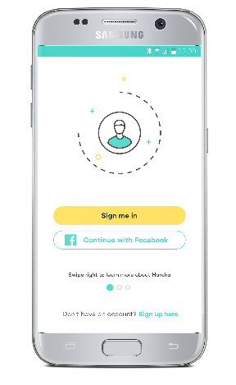
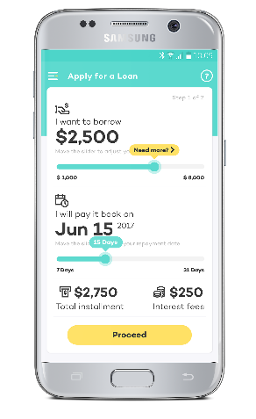



Haraka.
1
Client register with his/her Facebook details via Android smartphone.
2
An Artificial Intelligence (A.I.) algorithm analyse data from the client’s phone to determine the client’s affordability and predict credit risk.
3
Funds are disbursed using the client’s Mobile money account.
4
Our point system rewards clients that display positive repayment behaviour, and incentivises clients to share the app with friends.
| Page 10

Slide 20
20
AI for improved Customer Experience.

Slide 21
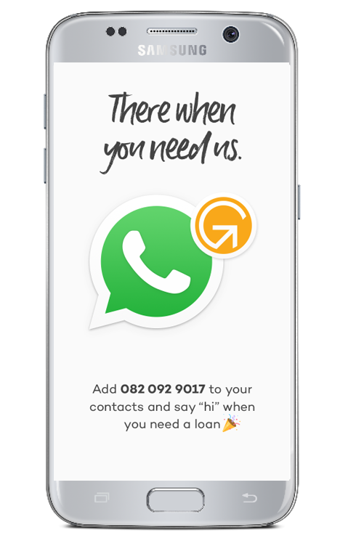
Virtual assistant (Tess).
Text-based virtual assistant
Use cases:
Lending: Assist with loan applications by predicting intent and interpreting queries over text channels, such as instant messaging apps.
Collections: Assist with collections by engaging with customers over text channels, such as instant messaging apps.
Banking: Virtual banker e.g. check balances and perform transaction in natural language e.g. ‘Tess what is my balance?’
Insurance: Assist with claims, quotations, customer service and sales.
Customer support on all channels: Assist with frequently asked questions on all channels e.g. website, apps, messaging apps etc.
Onboarding: Assist with onboarding on all channels across lending, banking and insurance.

Slide 22

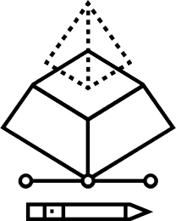






Automated Customer Relationship Management (CRM).
Predicting the next action of a client.
Predicting the best engagement option.
Probability that a client will drop-off
E.g., if likely that client will drop-off
What channel to use
(email, sms, whatsApp, pop-up, etc.)
When to engage
What message to send

Slide 23
Thank you.
Dr. Richard van der Wath
Group Chief Data Officer
Mobile: +27 71 384 3119
Phone: +352 2088 2123
Email: Richard@mybucks.com

Slide 24
Disclaimer.
Please note: This presentation is strictly confidential and is not to be duplicated or distributed without the written approval from MyBucks.

