Slide 1
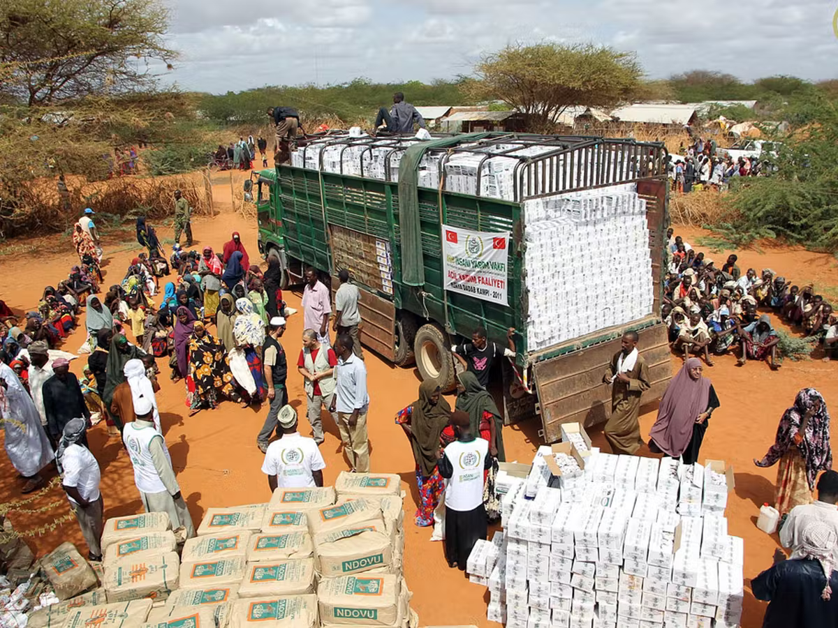

The Responsible
use of Data in International Development and Humanitarian Aid
www.linkedin.com/in/billhoggarth/
+27 8 2789 7503
billhoggarth@simprints.com

Slide 2
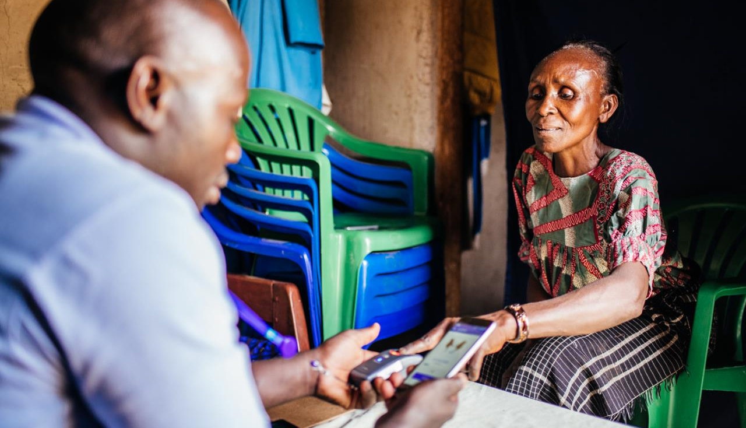
The Responsible
use of Data in International Development and Humanitarian Aid

Slide 3
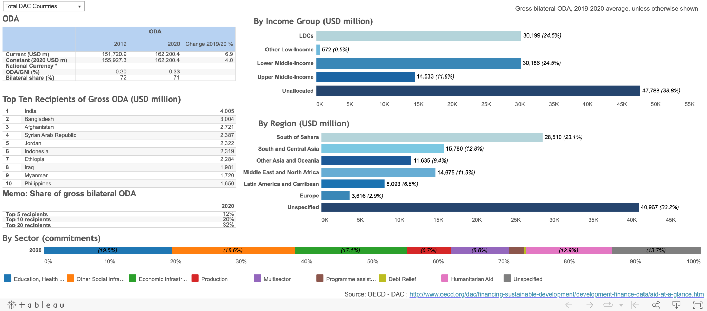

Slide 4
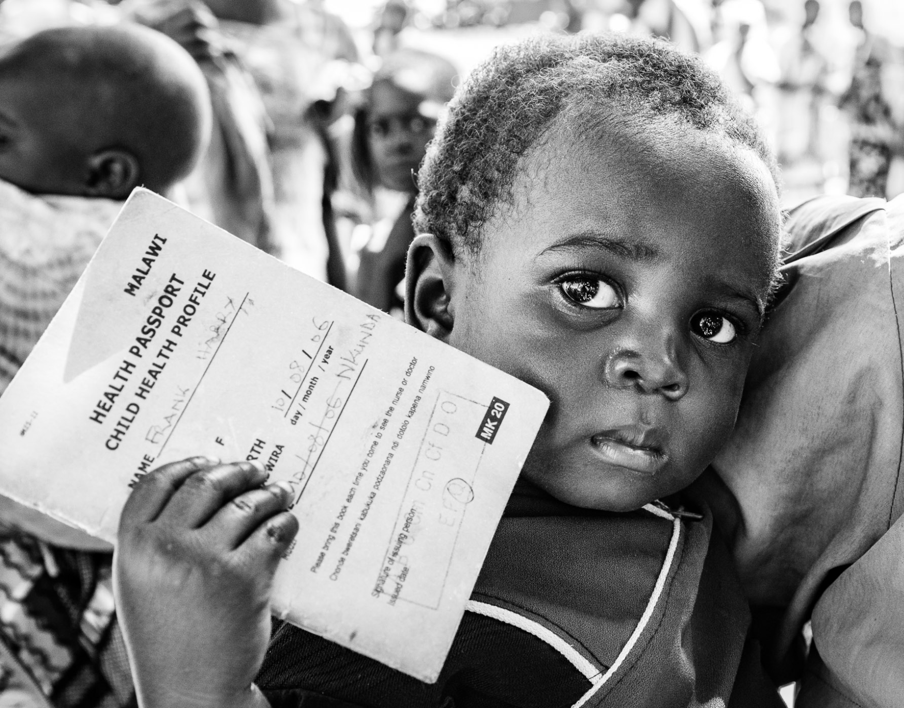
The Responsible
use of Data in International Development and Humanitarian Aid

Slide 5

A real-world example
According to a study by UNAIDS of Brazil, of an estimated 140 million records in the national user database only 100 million unique patients were represented.
Lack of reliable data for surveillance and monitoring
Ineffective policy interventions based on unreliable data
Extensive resources spent on un-needed tresatments

Slide 6

The Need for a Reliable ID
Over 1 billion people are invisible in the eyes of the world
Lack of formal ID or fear of disclosure

Slide 7
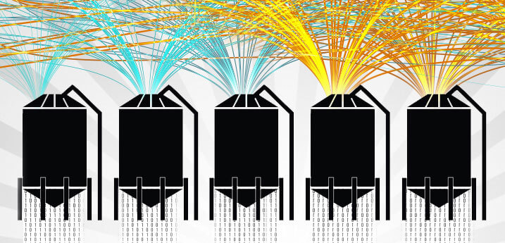
USAID supports over 4,000 organisaitons
>220,000 NGOs in South Africa

Slide 8
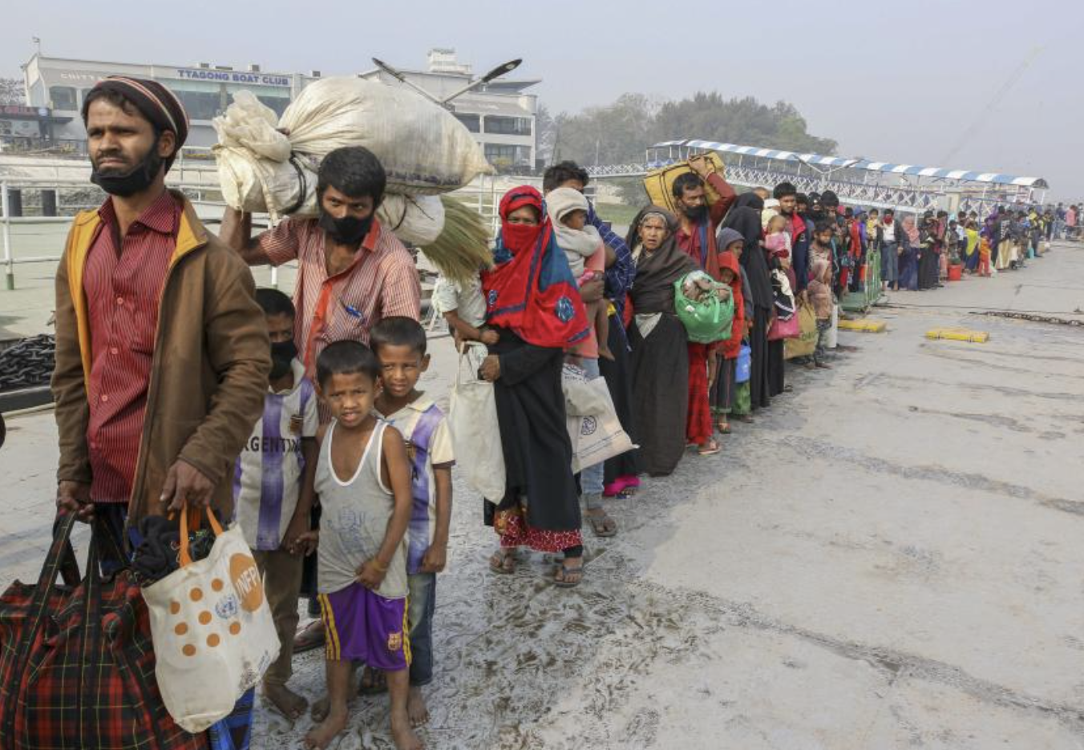
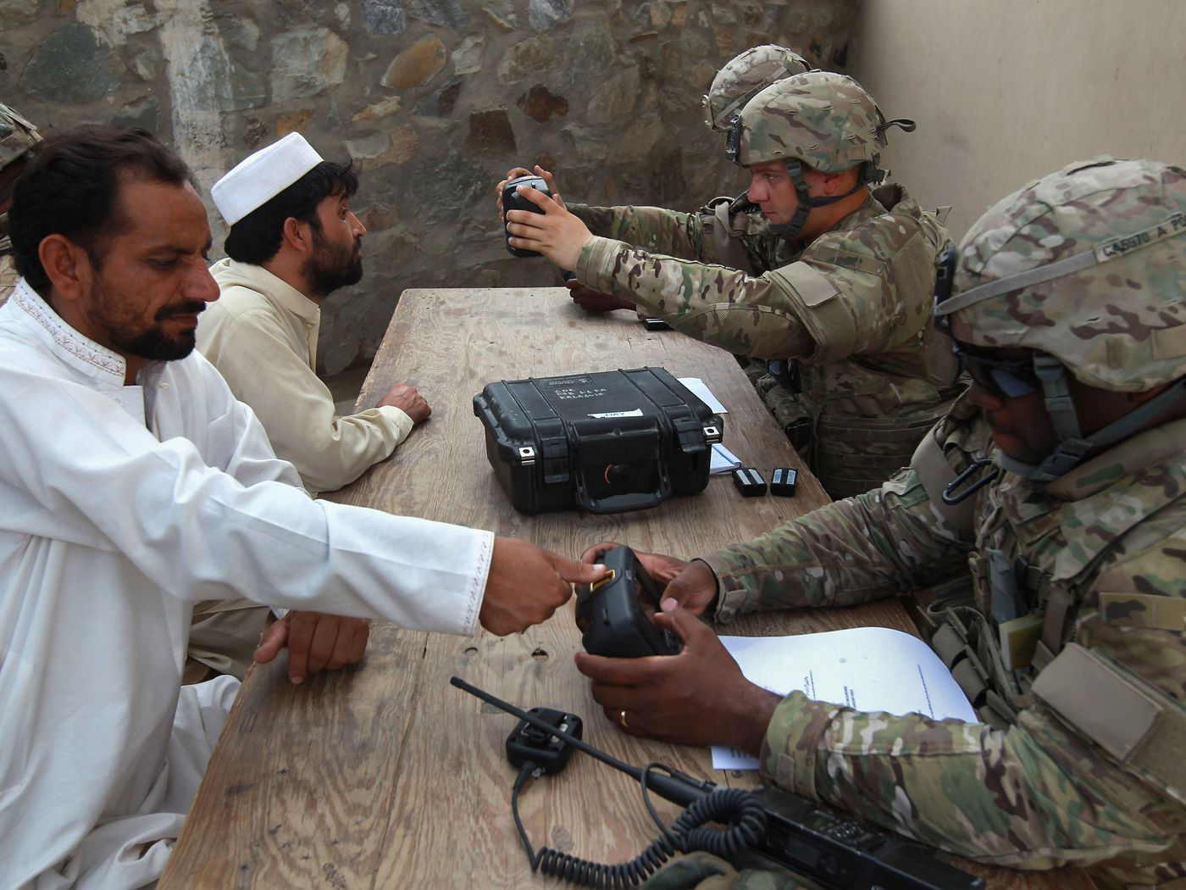
New Evidence That Biometric Data Systems Imperil Afghans
Taliban now Control Systems with Sensitive Personal Information
The Responsible
use of Data in International Development and Humanitarian Aid
UN Shared Rohingya
Data Without
Informed Consent
Bangladesh Provided
Myanmar Information
That Refugee Agency
Collected

Slide 9

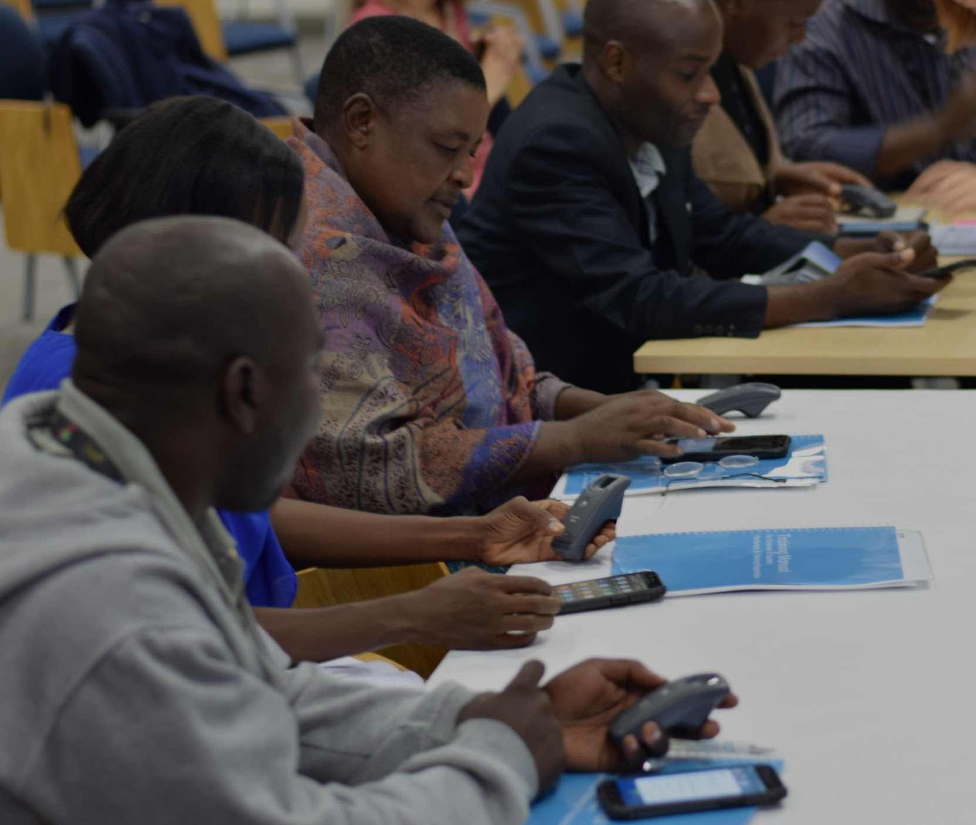
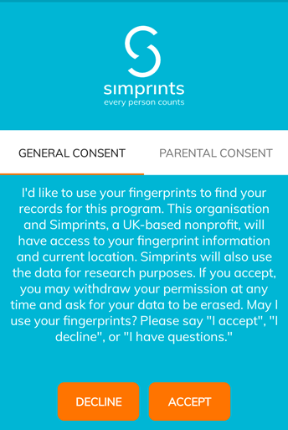
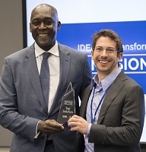
Respecting privacy
1
Legal: adhere to strictest standards
“I would prefer the fingerprint scanning to the SIM card scanning because the SIM card would be seen by everyone, but no one would know whose finger it is. It is private.”
- Woman re-initiating ART in a clinical trial in Malawi
2
Operations: implement privacy principles in context
3
Advocacy: stronger privacy protections

Slide 10
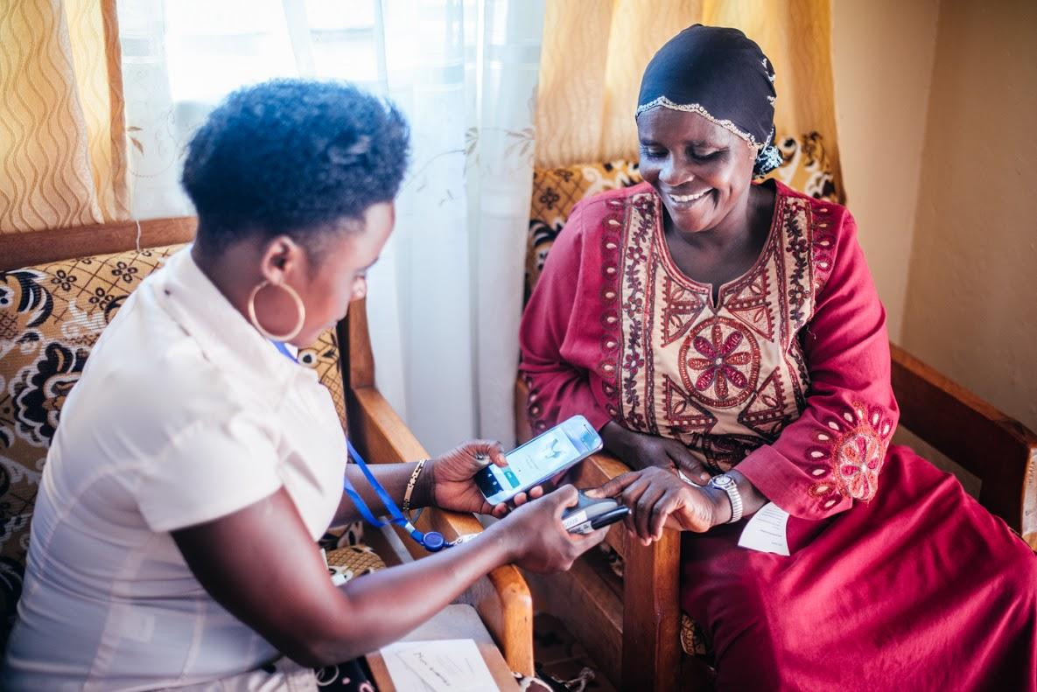




Verified data can drive impact
Malawi: >62% increase in women linked to HIV care records
Bangladesh: 39% increase in maternal health coverage
Ethiopia: 98% recorded patients received deworming pills, vs 69% in control districts

Slide 11
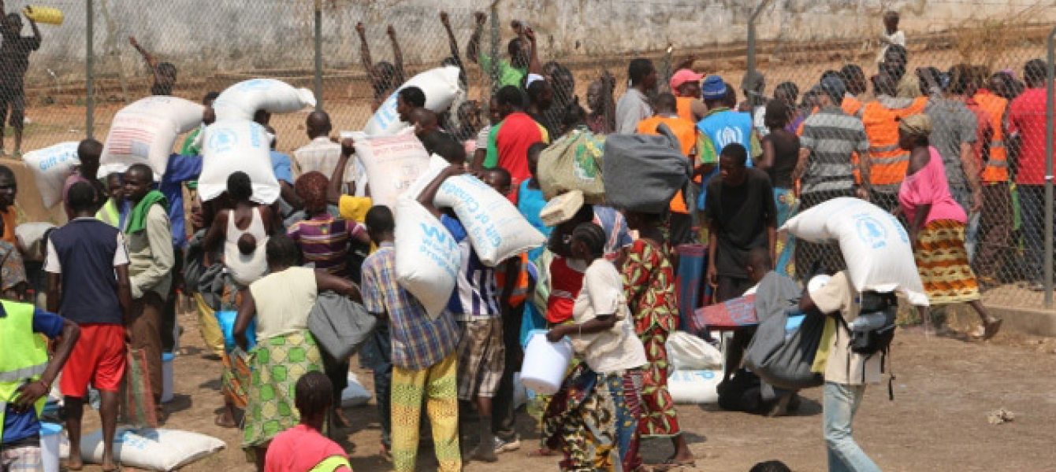
What to do?
Partnerships
Time, Money, Effort
Government Led

Slide 12
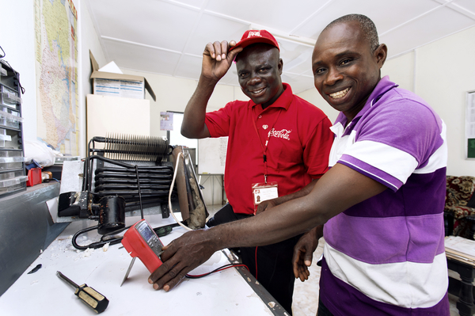
Project Last Mile
Project Last Mile
The Coca Cola Company, BMGF, The Global Fund
National Governments
Advice and Capacity Building
Logistics, Cold Chain, Demand Generation
Partnerships

Slide 13






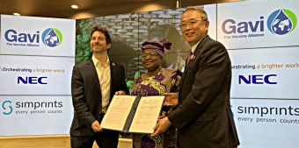
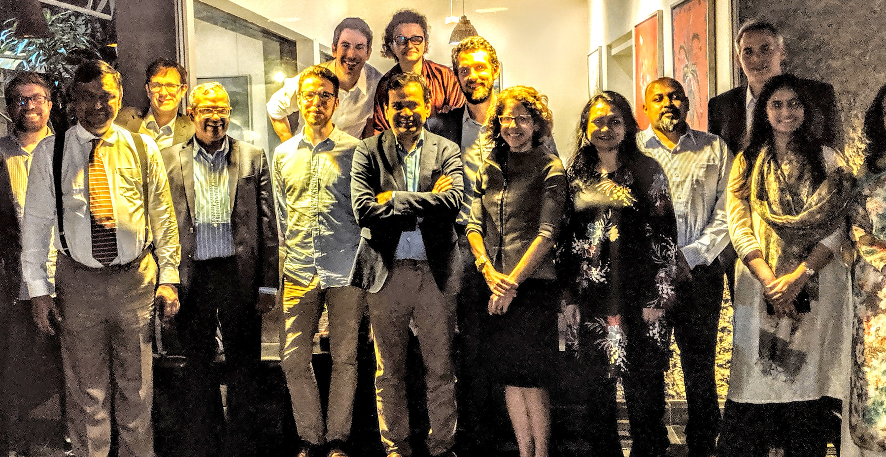
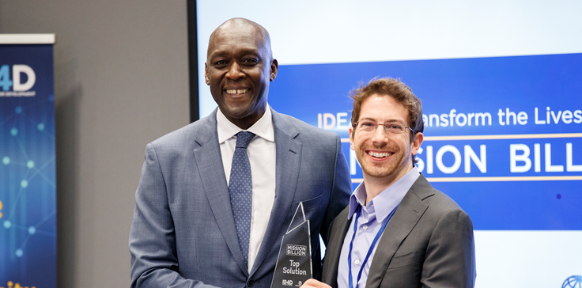
We partner with world-leading organizations
Technology Partners
Project Partners
Thought Leaders
2019 MoU for R&D
Child fingerprint collaboration
2019 ‘Mission Billion’ winner
Contributed to tech standards
MoH partners in Ghana, Ethiopia, Bangladesh, and India
Core funding
Engineering support
$3.5M vaccine project
2018 Pacesetter
Co-Authored whitepaper
2017 Schwab Fellow
NEC, Gavi, and Simprints MoU signing to develop world’s first child fingerprint solution
BRAC’s Executive Director, Asif Saleh, hosting the Simprints Board of DIrectors
Simprints taking 1st prize in the World Bank’s challenge to improve user-centred privacy

Slide 14

The Vital Data Project
Verifiable, Impactful, Trusted,
Accurate, Life-Saving
Money
People
Time
Resources

Slide 15
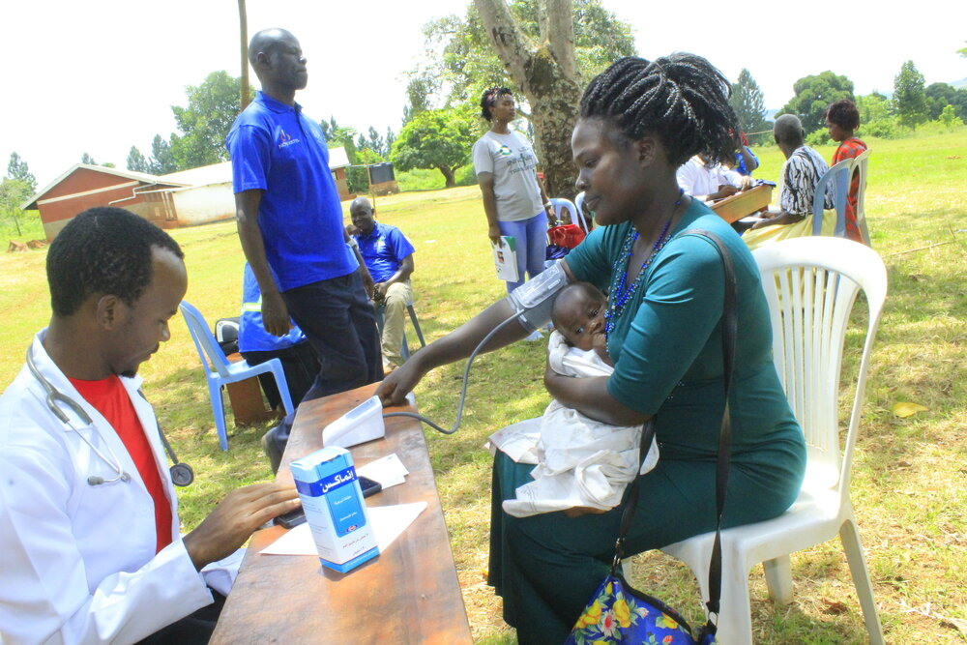
Volunteer Brainstormers
Meet 2-3 times during 2022
Establish ToR and MVP
Prepare for approaches to
    Funders (CSR)
Government
Vendors

Slide 16
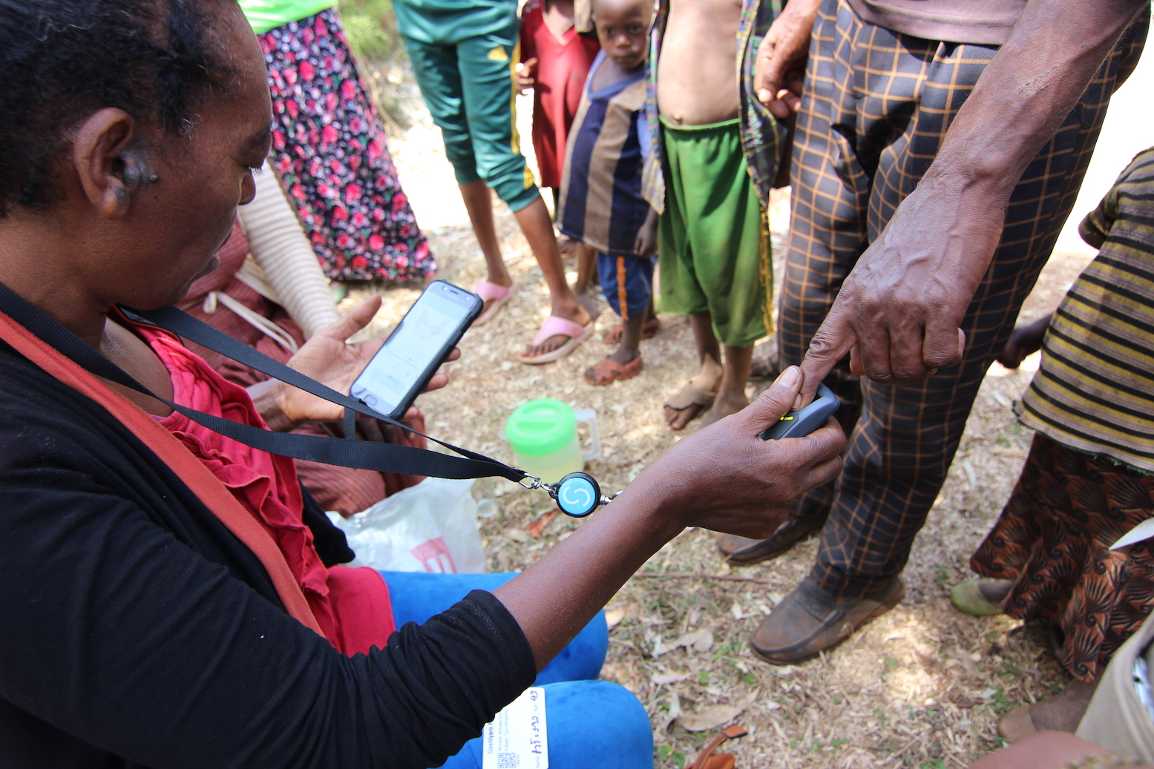


Thank you!
Want to work together on brainstorming how we can save lives ?
billhoggarth@simprints.com
+27 82 789 7503
www.simprints.com

